Slide 1
Closed space-filling curves with controlled orientation for 3D printing
A. Bedel^{1†}, Y. Coudert-Osmont^{1†}, J. Martínez¹, R. I. Nishat², S. Whitesides³, S. Lefebvre¹
¹Université de Lorraine, CNRS, Inria, LORIA
²Ryerson University
³University of Victoria
†Joint first authors
Notes:
Hello everyone, this is the talk of the paper “Closed space-filling curves with controlled orientation for 3D printing”, presented at Eurographics 2022.

Slide 2
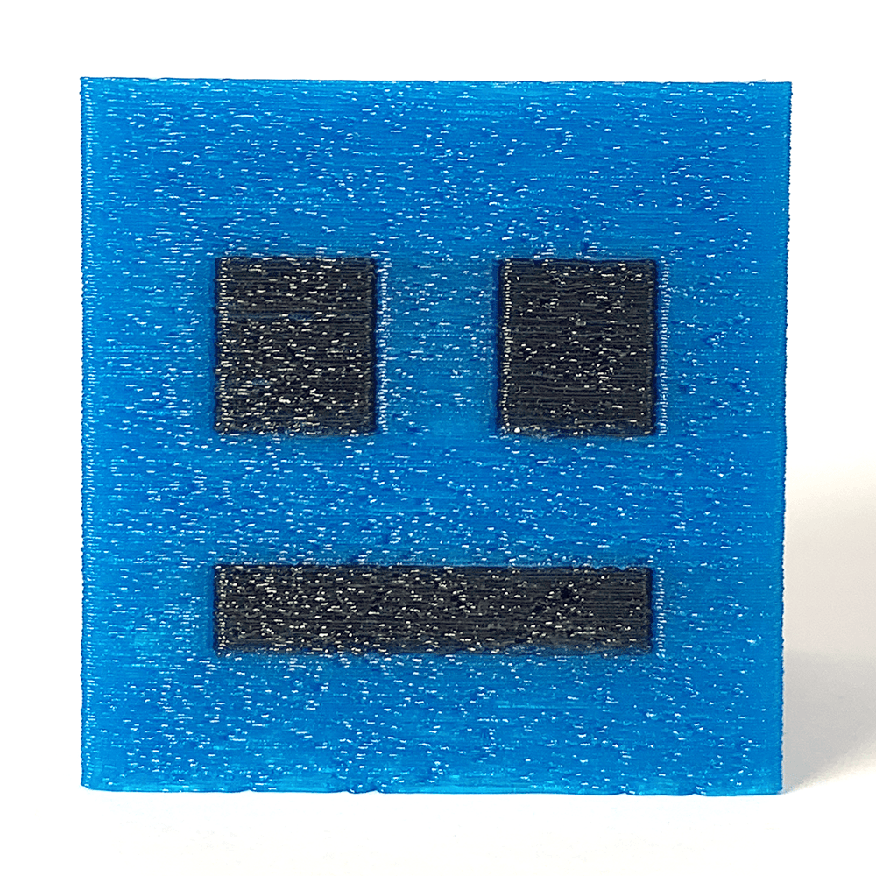
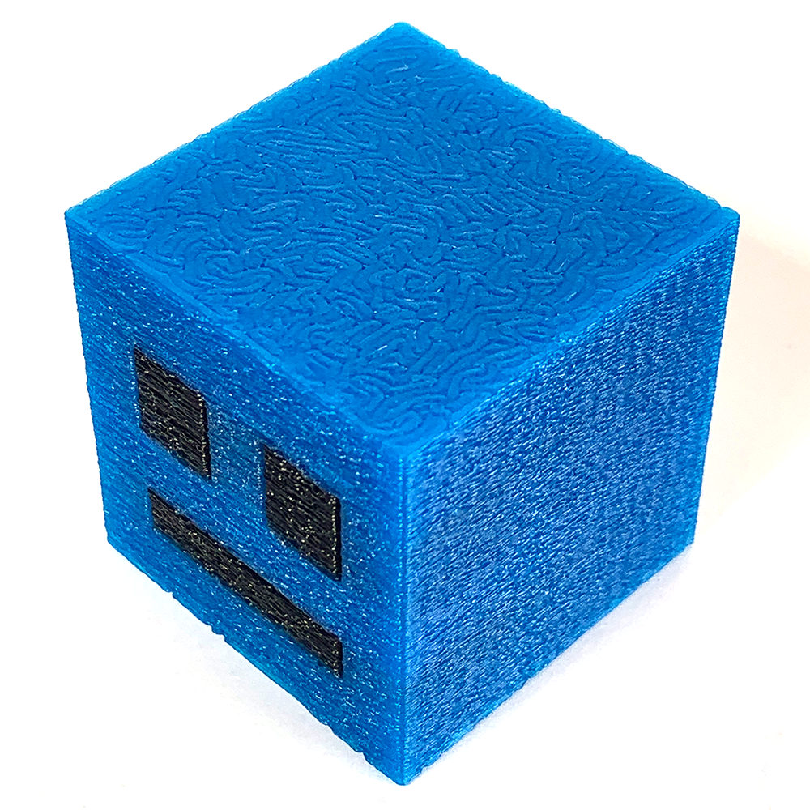
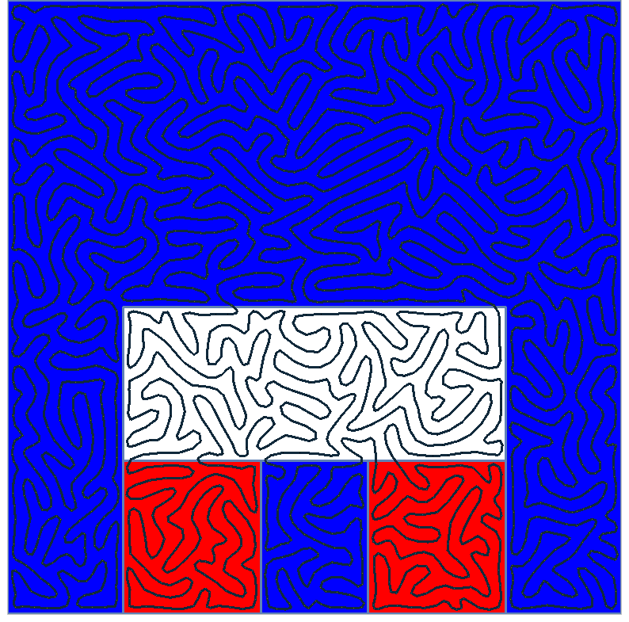
Context
How to design/optimize a layer trajectory?
2
Notes:
This work takes place in the context of 3D printing where we aim to print 3D objects by depositing a fused filament layer by layer.
Here I show a small smiley cube created by 3D printing. You can see the trajectory followed by the printing nozzle on the top of the cube in the middle image. An image of the trajectory as seen on a computer is on the right.
========================
One question that arises in such a process is, "How can we design or optimize a layer trajectory?"

Slide 3
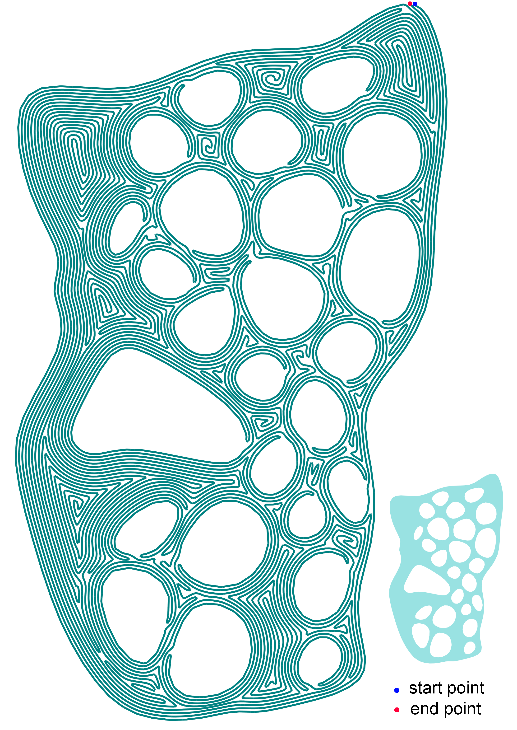
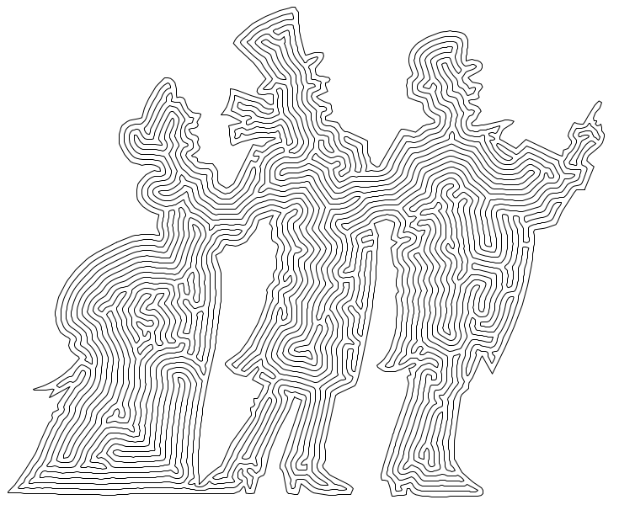
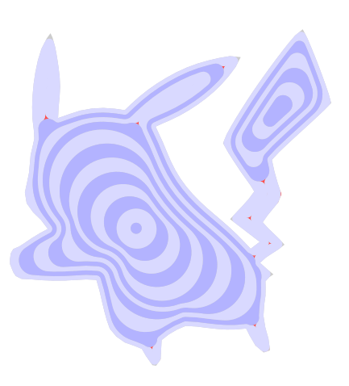
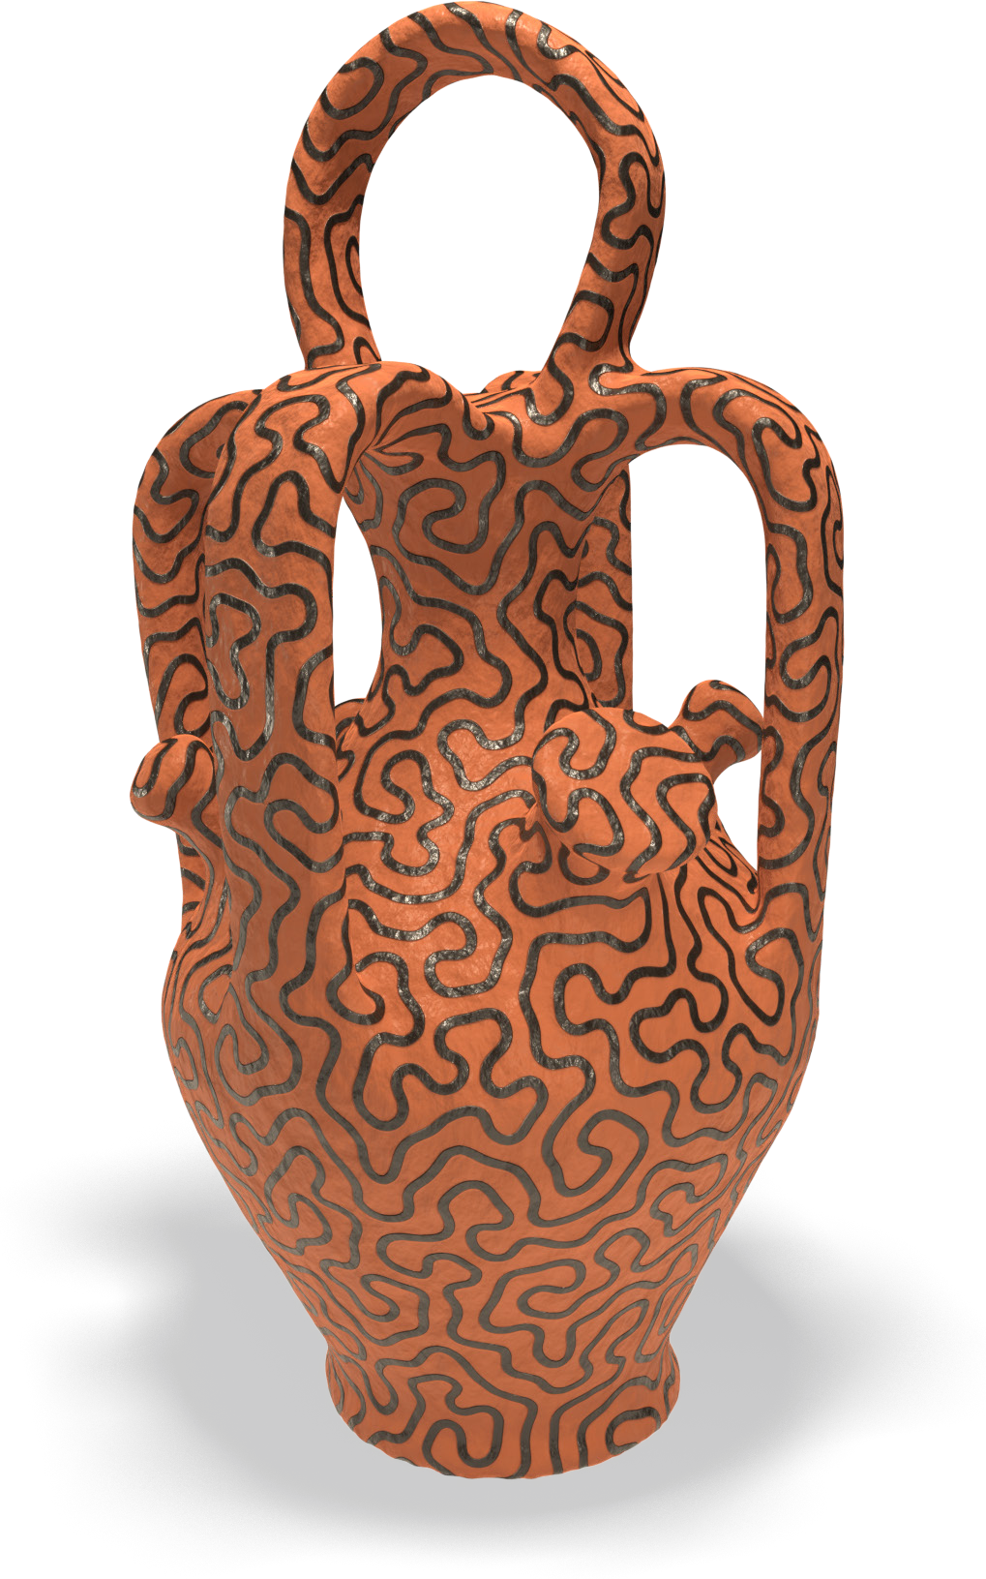
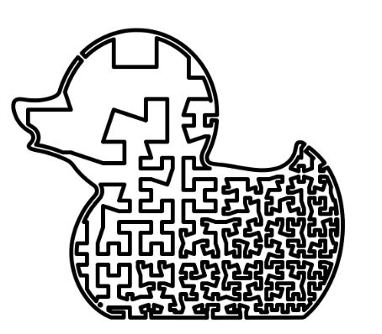
Previous Work
[Pedersen et al. 2006]
[Hornus et al. 2020]
[Kuipers et al. 2019]
[Zhao et al. 2016]
[Sharp et al. 2018]
3
Notes:
Many previous work tackle this problem.
Hornus et al design trajectories with varying width in order to optimize for filling density
Kuipers et al create sparse continuous infills with prescribed density
Other works grow space-filling curves from initial simple closed curves. Their growing processes are locally influenced allowing control over the final curve.
Finally Zhao et al generate space filling curves called Fermat spirals that are continuous and contour aligned.
Of course there are many other works on the subject but let's talk about our work now

Slide 4
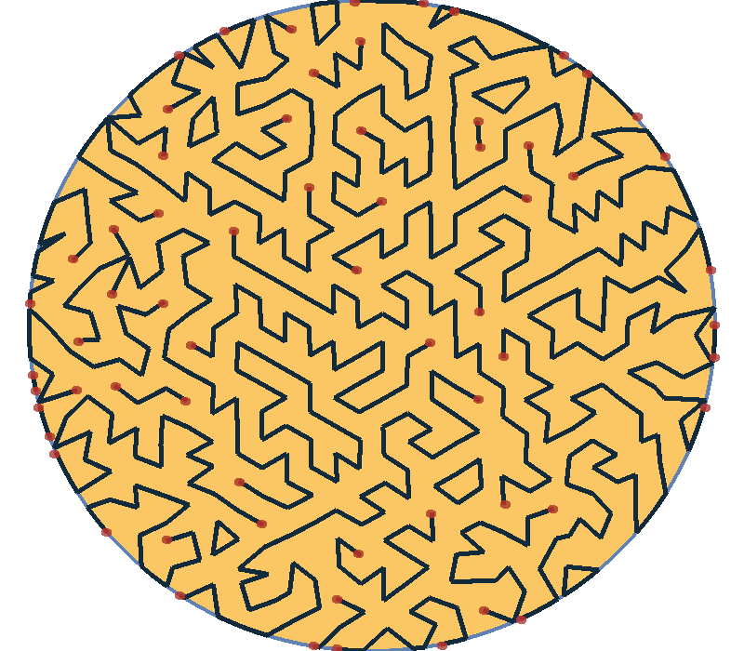
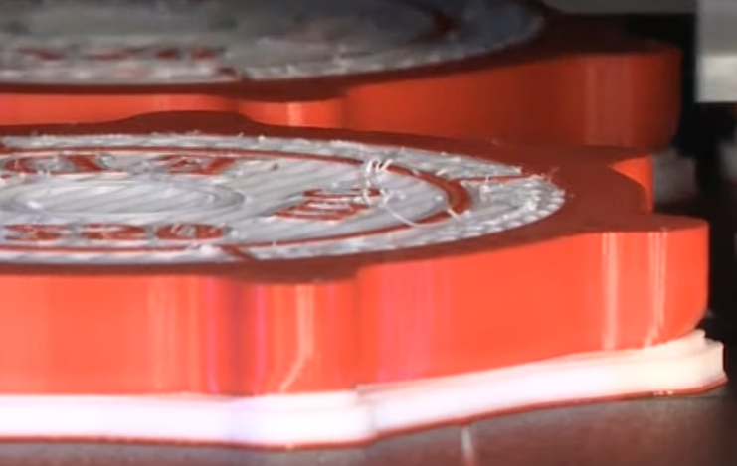
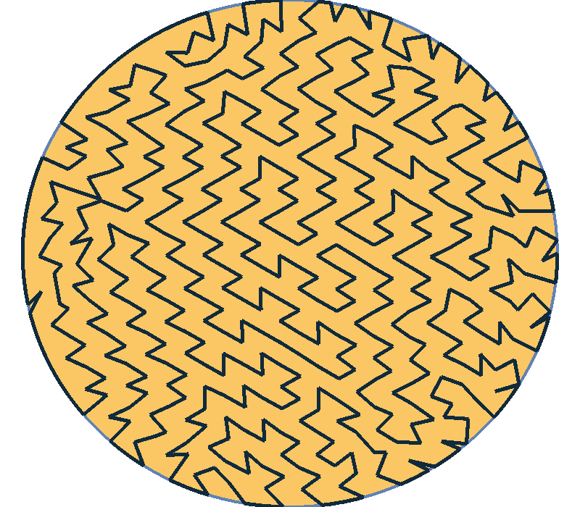
Motivation
Closed Continuous Path
Save time
Avoid spurious deposits
4
Notes:
We take a particular point of view with two main concerns.
The first one is that we want to design closed continuous trajectories, namely cycles.
Thus our method should not generate the leftmost trajectory that has many start and end points.
The rightmost trajectory is preferable.
In fact it saves time since it is not necessary to stop the deposition at each end point, and then move to a new starting point to restart the deposition again.
Furthermore, it avoid spurious deposits as the filament can ooze during travel moves.

Slide 5
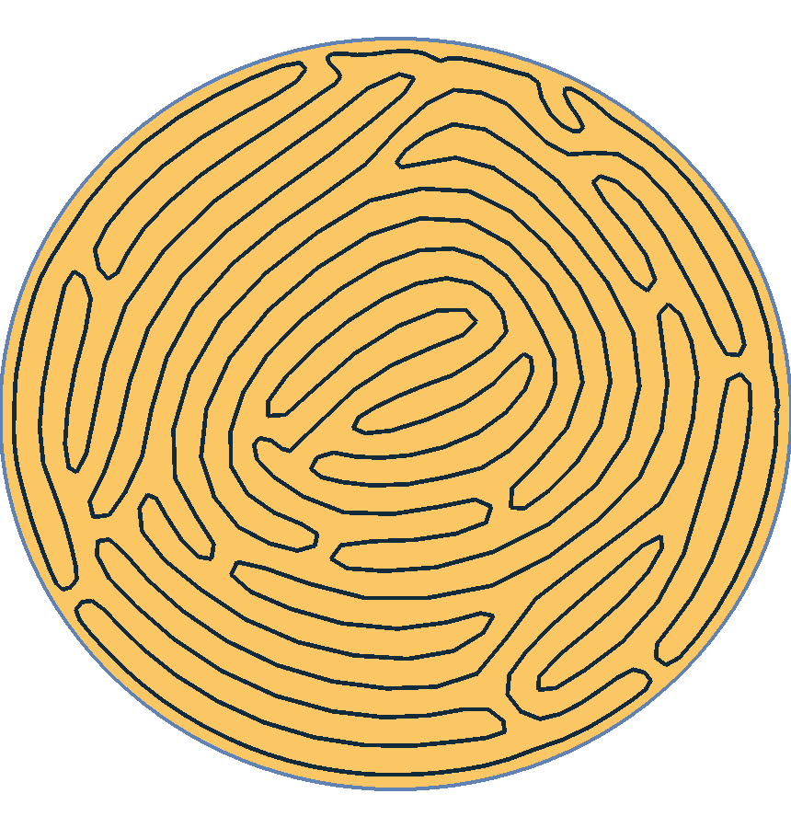
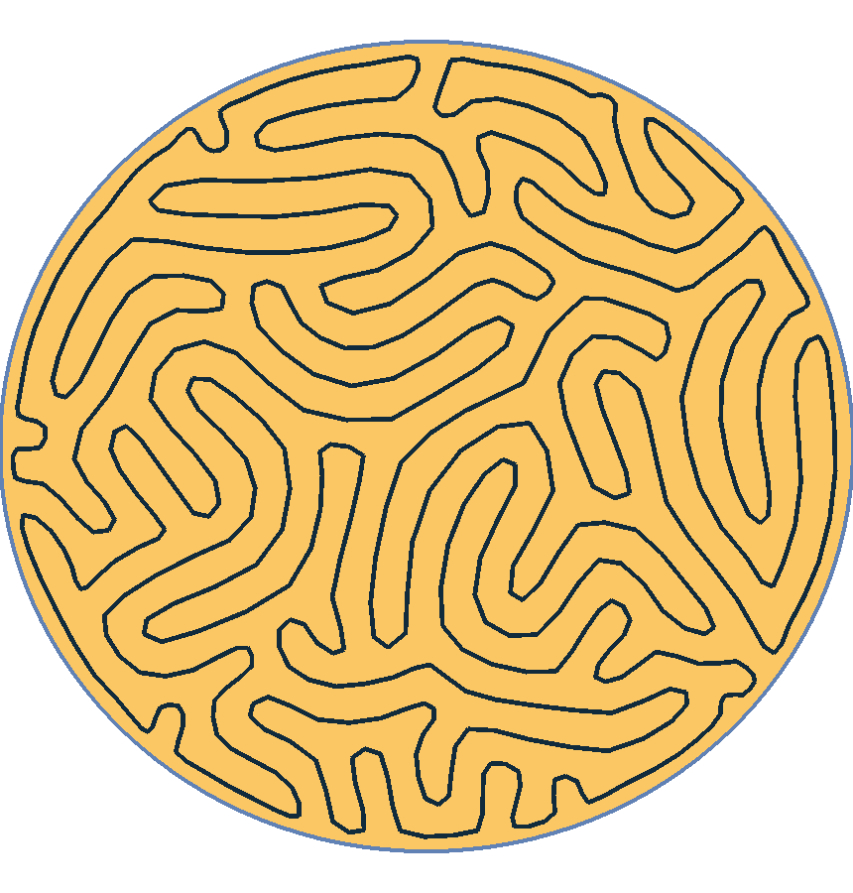
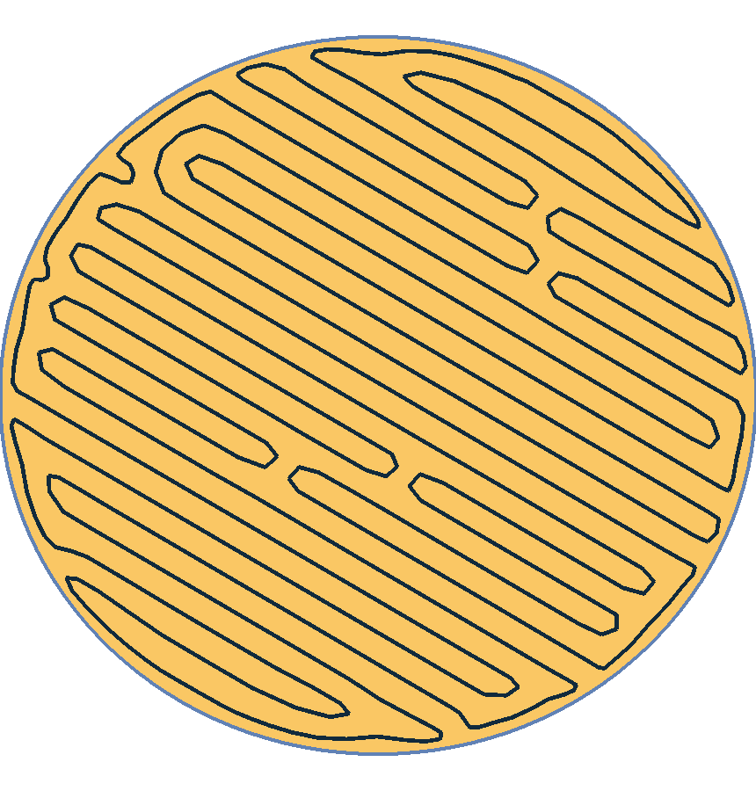
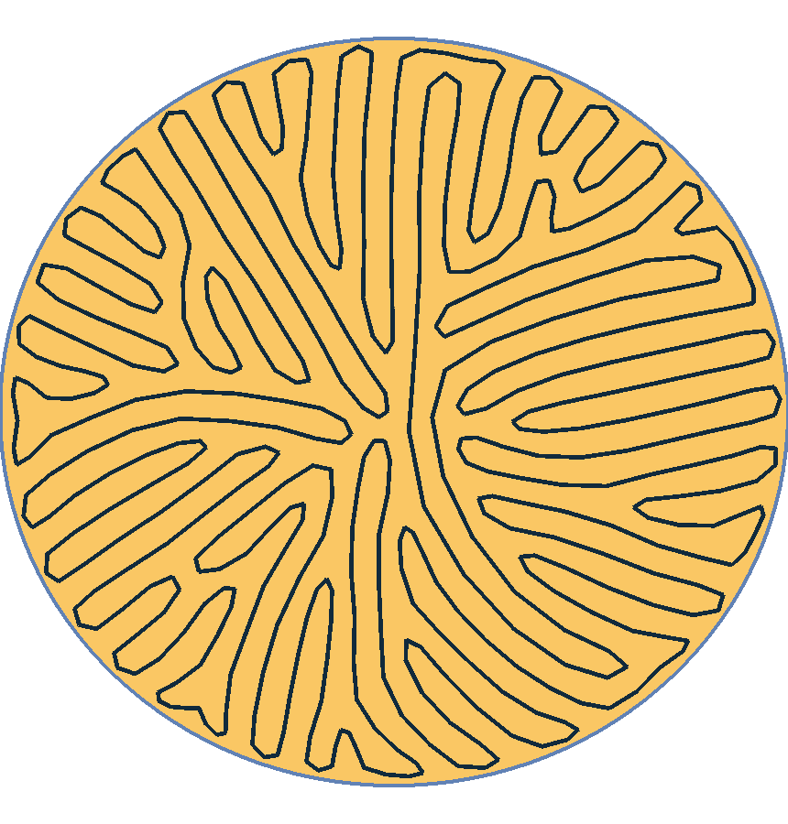
Motivation
Controlled Orientation
Vector Field
Alignment
Isotropy
Anisotropy
5
Notes:
The second main concern is the control over orientation. In fact, orientation has a direct impact over surface roughness and mechanical properties of the printed object.
We want to allow the user to optimize for isotropy or anisotopy.
For more control we also propose to align the trajectory with a prescribed vector field. Here I show the two vector field that are most often used. One is contour aligned while the other is simply the field orthogonal to the first one giving a radial alignment.

Slide 6
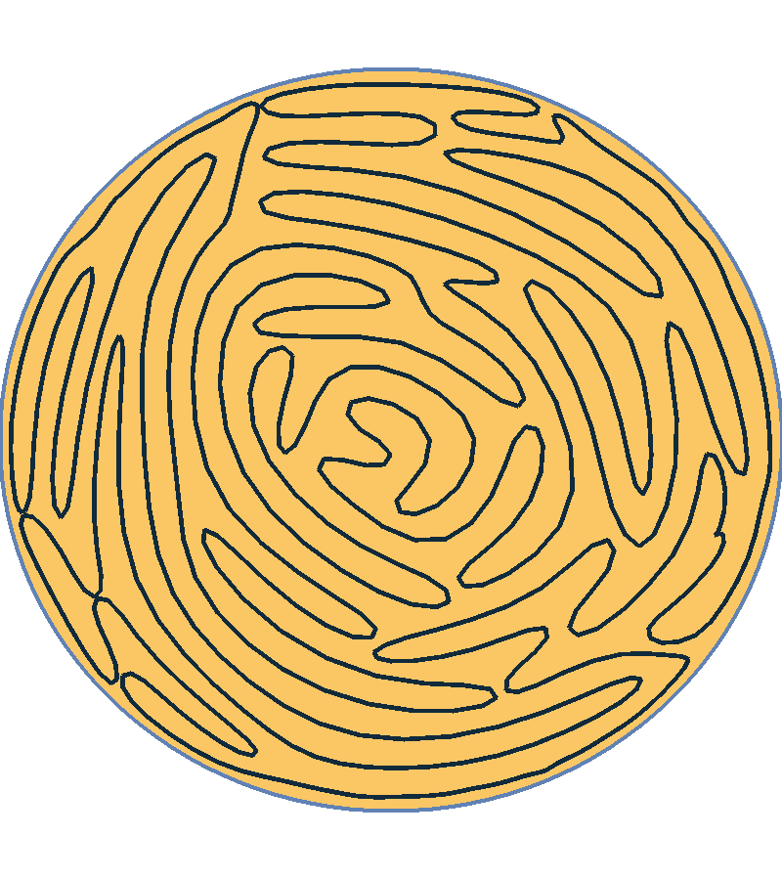
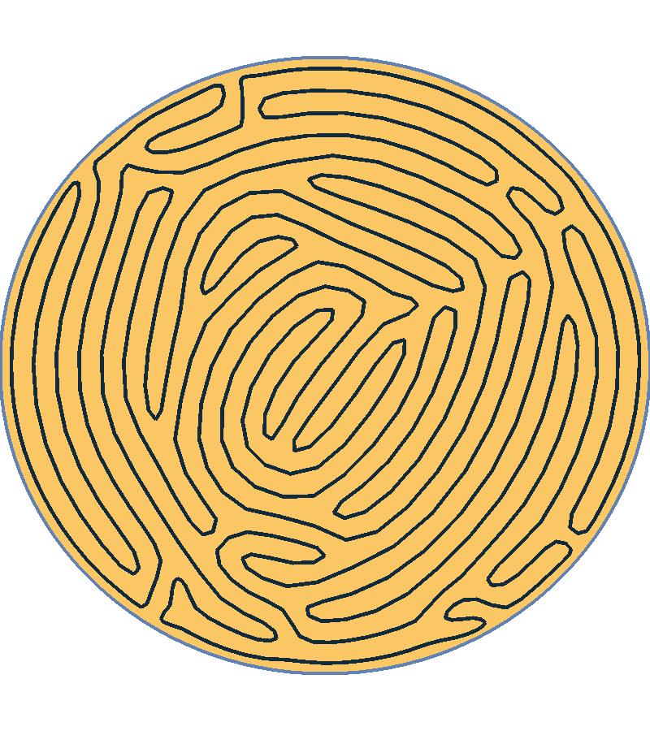
Motivation
Even Spacing
uneven
even
6
Notes:
Additionally we decided to generate trajectories with even spacing.
This avoid auto-intersecting or almost auto-intersecting path
And it is often desirable to have a uniform printing density as shown in the right image instead of having a varying density as illustrated on the uneven trajectory where the density seems higher on the left than in the center.

Slide 7
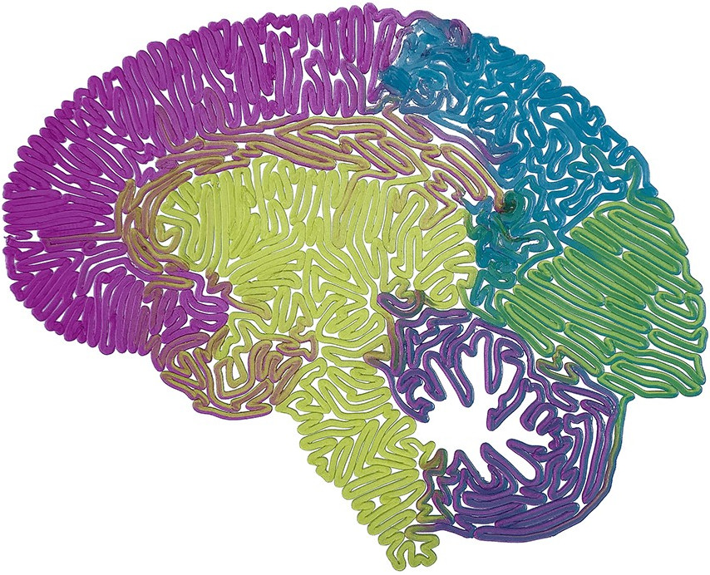
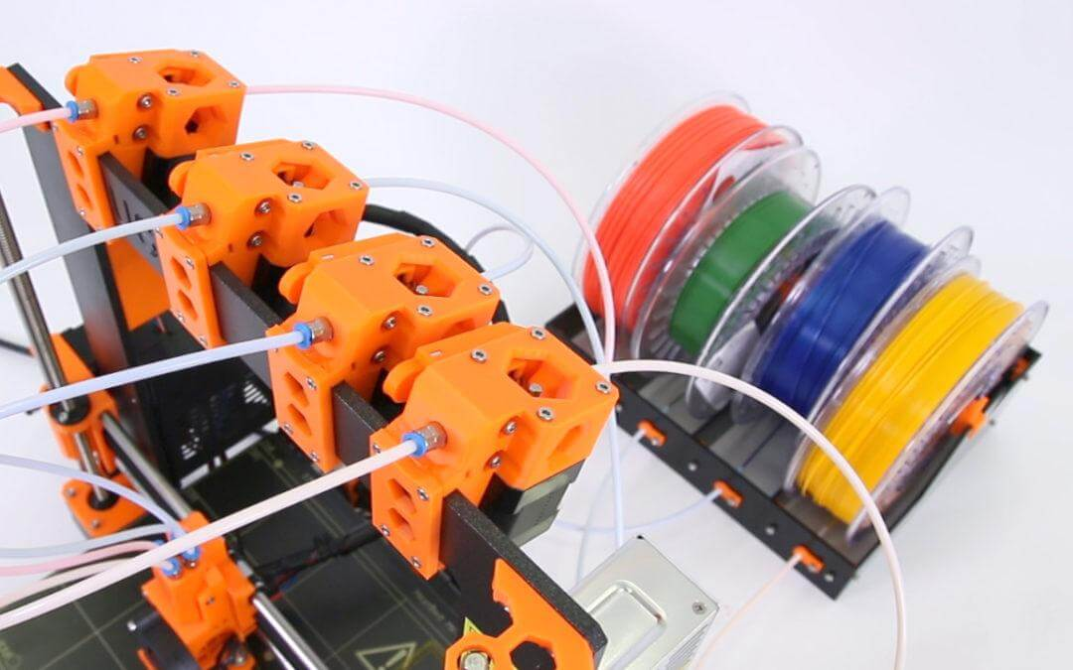
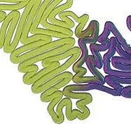
Motivation
Colored Prints
Prusa i3 printer
7
Notes:
A final challenge is for colored prints. Not the most important concern but still interesting.
Some printers allow to pull more or less different colored filaments at the same time allowing to change colors along the path.
Unfortunately the transitions take a long time, resulting in printing defects.
It is then interesting to limit the number of transitions between zones of different colors.

Slide 8
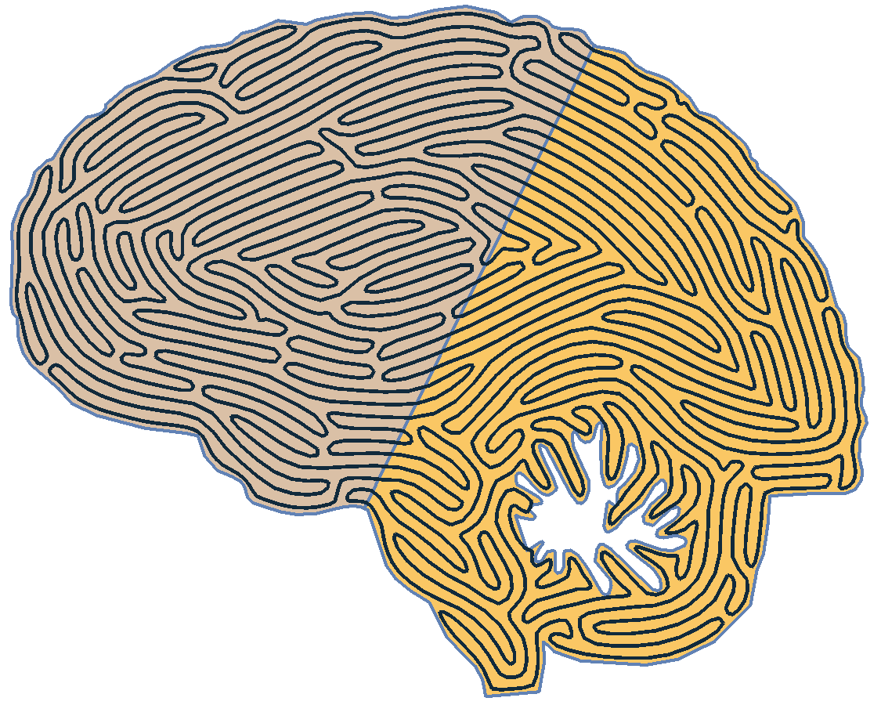
Motivation
Colored Prints
36 transitions
2 transitions
8
Notes:
If we look at these two trajectories.
We can see that the first one contains 36 transitions that would lead to a poor quality print.
While the second one contains the minimal number of transitions for a closed filling curve which would result in a much better print.
In practice we would like to obtain this minimum number of transitions as often as possible.

Slide 9
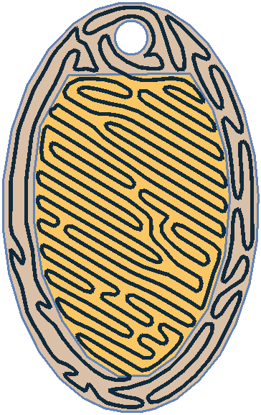
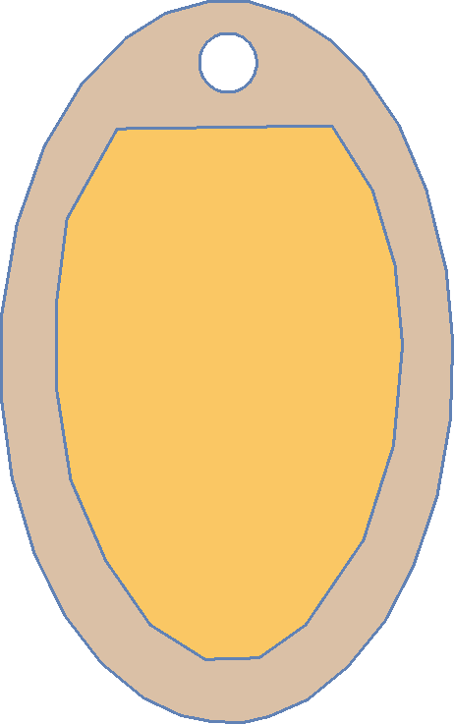
Overview
Input
Output
Contour aligned
Our Algorithm
Anisotropy
9
Notes:
Let’s give an overview of our method for generating trajectories. We take as input a surface on wich we want to compute a closed space filling curve. This surface could contain zone of different colors. Here two colors are used for the locket shown in example.
The model can be provided with several orientation objectives. Here we choose anisotropy for the central yellow part and contour alignment for the outer part.
Then our method should generate a smoothed trajectory by addressing all the points presented earlier (closeness, orientation, even spacing and minimal number of color transitions).
This is done in two main stages.

Slide 10
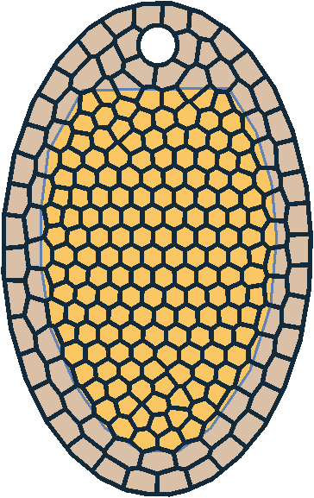
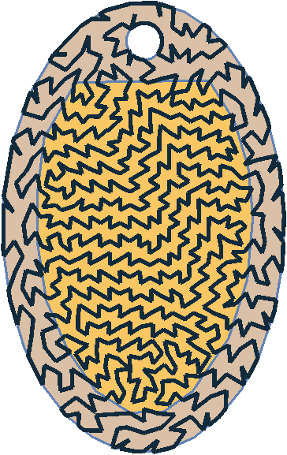
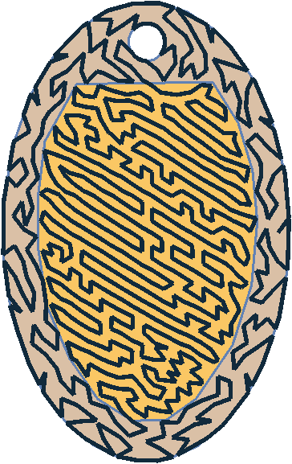
Overview
Input
Combinatorial Stage
Geometric Stage
Contour aligned
Get a cycle covering the surface
very quickly
Optimize the geometry
(e.g. smoothing)
Anisotropy
Graph Covering
Refinement
+ initial H. cycle
Stochastic
Optimization
Geometry
Optimization
10
Notes:
The first one is the combinatorial step in which we want to cover the surface very quickly with a graph in which we can extract a Hamiltonian cycle covering in its turn the surface.
This is followed by a geometric stage in which we smooth the trajectory. In both stages, we address the 4 objectives described earlier.
To go into a little more detail about the pipeline we can subdivide the combinatorial stage into three steps.
The first one is the construction of a graph covering the surface using a Centroidal Voronoi Tesselation.
This is followed by a graph refinement adding new vertices and by the efficient computation of an initial Hamilton cycle.
Finally a genetic algorithm is used to optimize the cycle by applying some local modification conserving the Hamiltonian property.
At this step we can already observe anisotropy in the yellow part and a minimal number of transitions between the two colors.
However we can still further improve the smoothness of the trajectory as well as the even spacing and orientation objectives in what we call a geometric stage.
Now, let's take a deeper look at our method.

Slide 11
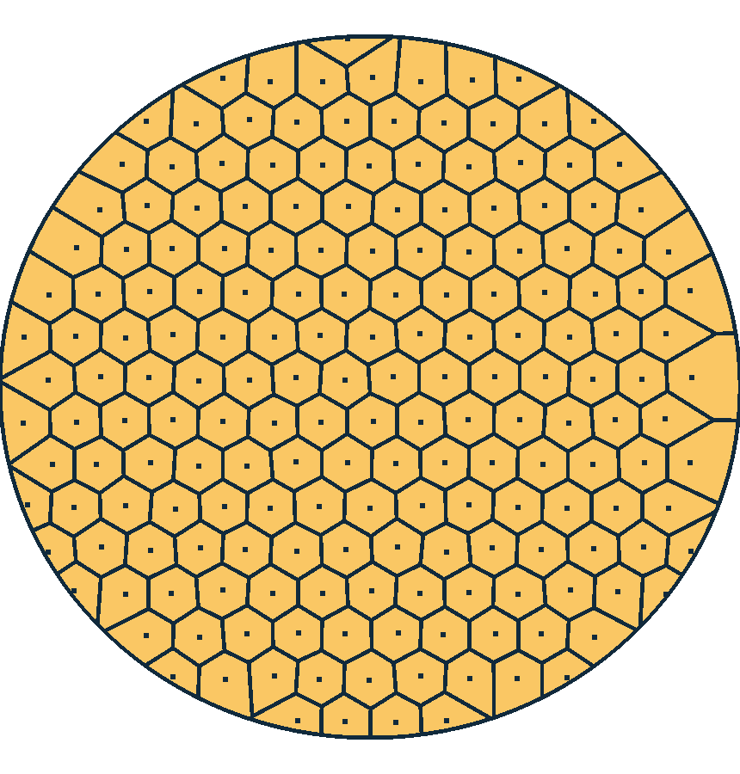
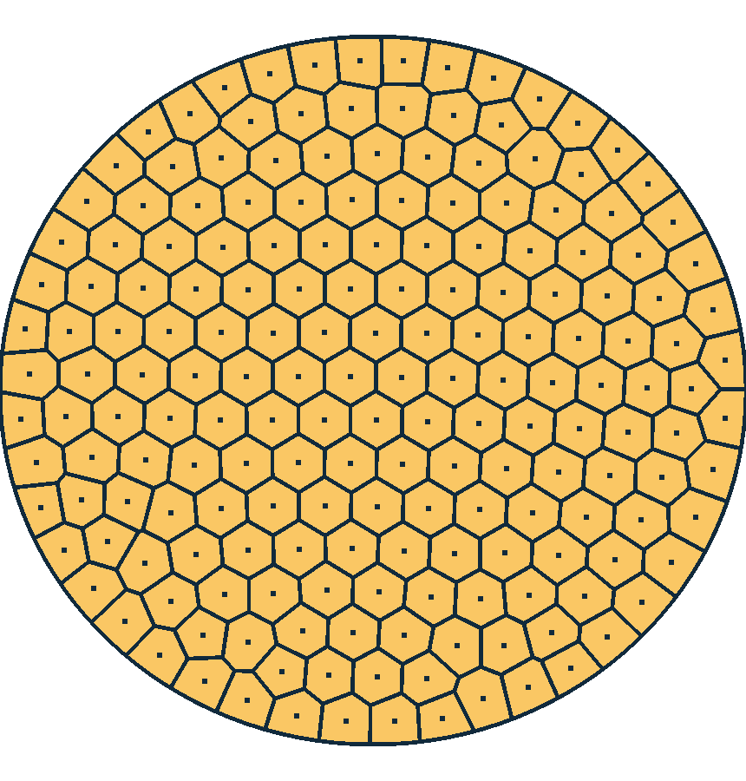
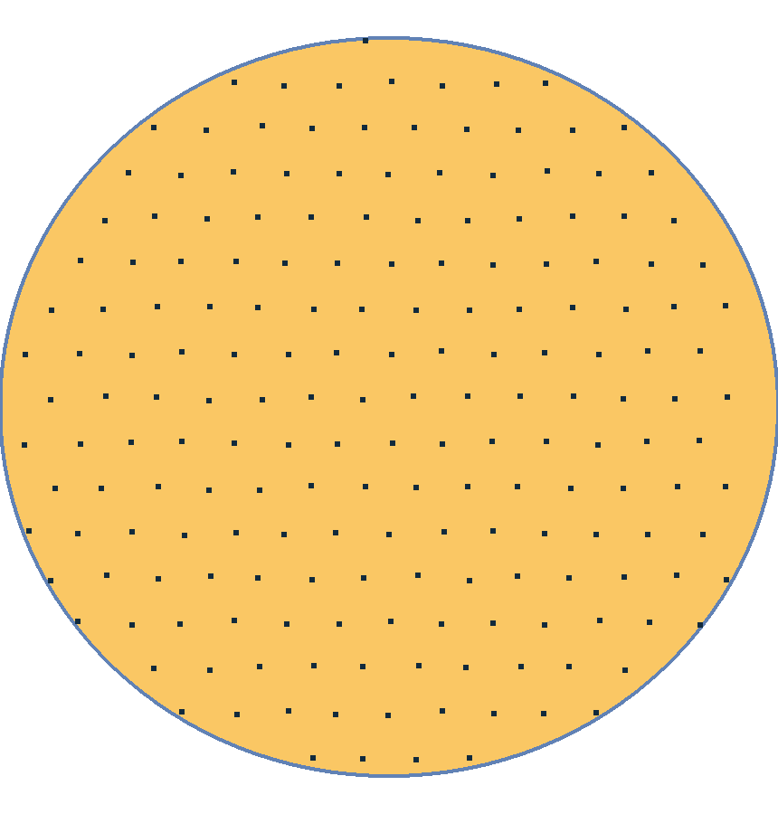
Graph Construction
Voronoï Diagram
Centroidal Voronoï Tessellation (CVT)
$$min\int_{S}{dist}{\left(x,Seeds\right)}^{2}dx$$
Triangular Tiling
S: Surface
11
Notes:
We start with the graph construction. If we want to achieve even spacing in the trajectory the vertices of the graph must be evenly distributed over the entire surface.
We thus decide to use the Graph of a Voronoi Diagram, starting by placing seeds on a triangular tiling.
Then, we compute the Voronoi Diagram of these seeds giving a nice first graph.
To Further improve it, especially near boundaries, we compute a Centroidal Voronoi Tesselation by minimizing the squared distance to the nearest seed inside the surface S using a Quasi Newton optimizer called L-BFGS.

Slide 12
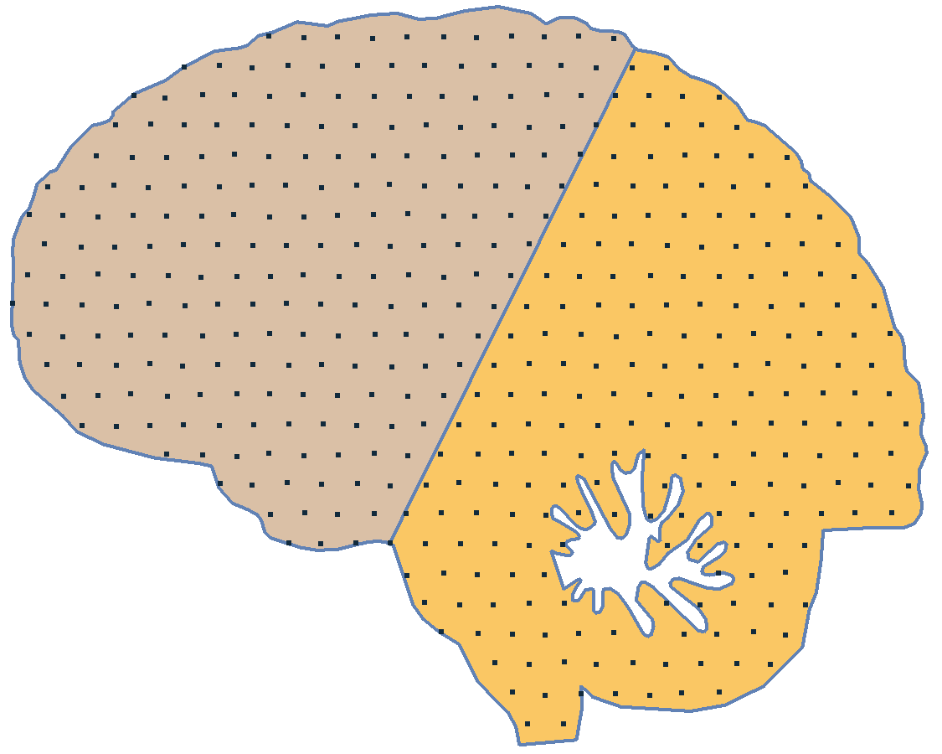
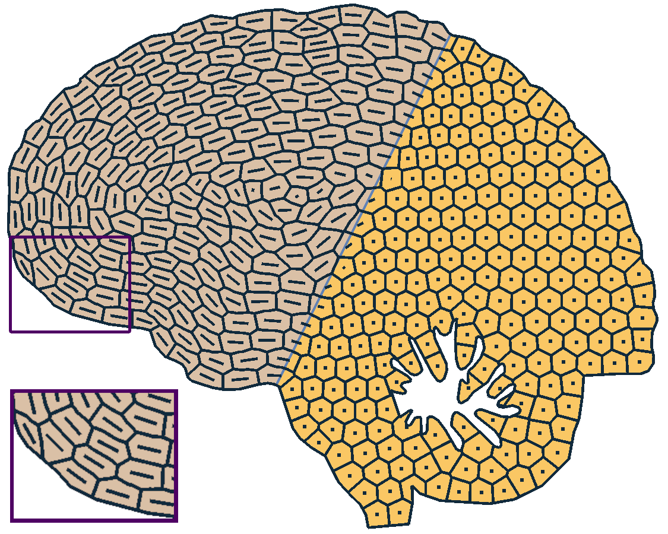
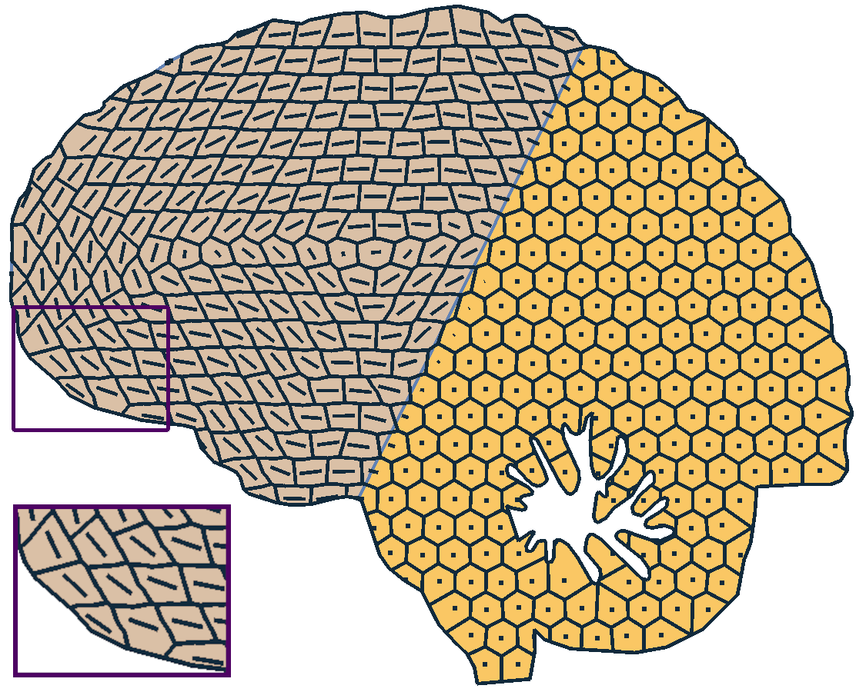
Graph Construction
Graph Anisotropy
Contour Alignment
CVT steps
CVT steps
Needle
12
Notes:
An important thing when generating the graph is the introduction of anisotropy in the orientation of edges. Indeed, otherwise we cannot optimize for alignment if no edge is aligned with the prescribed vector field.
In the shown example we want contour alignment in the left part of the brain. We thus replace seeds by small needles aligned with the contour and we use a Segment Voronoi Diagram introducing the desired anisotropy inside the graph.
As before, we apply a Centroidal Voronoi Tesselation to improve even spacing. You can read the paper for more details on the energy gradient when using needles

Slide 13
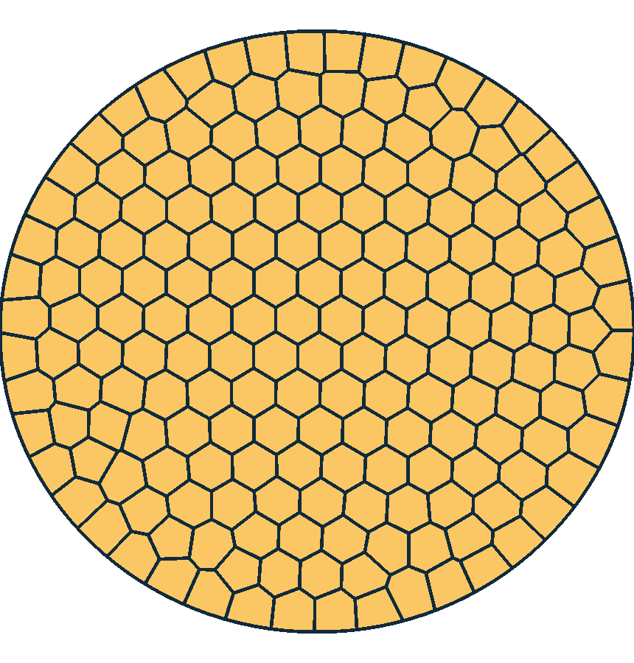
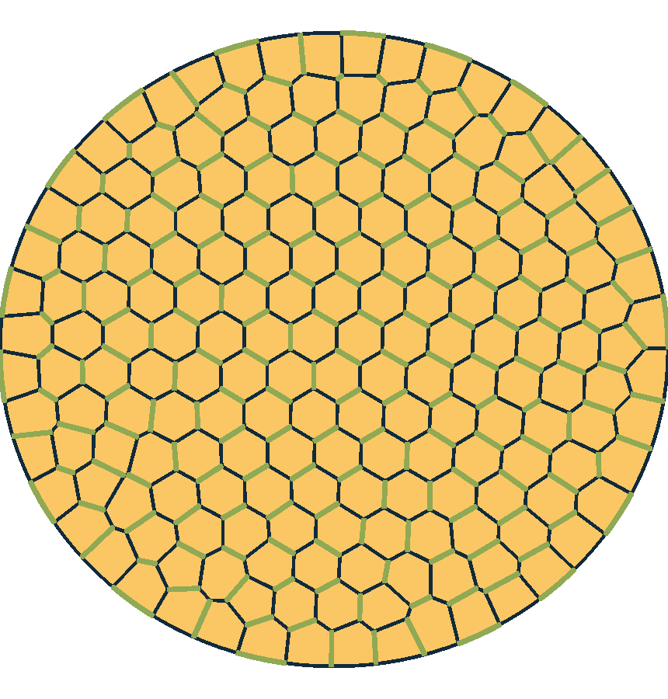
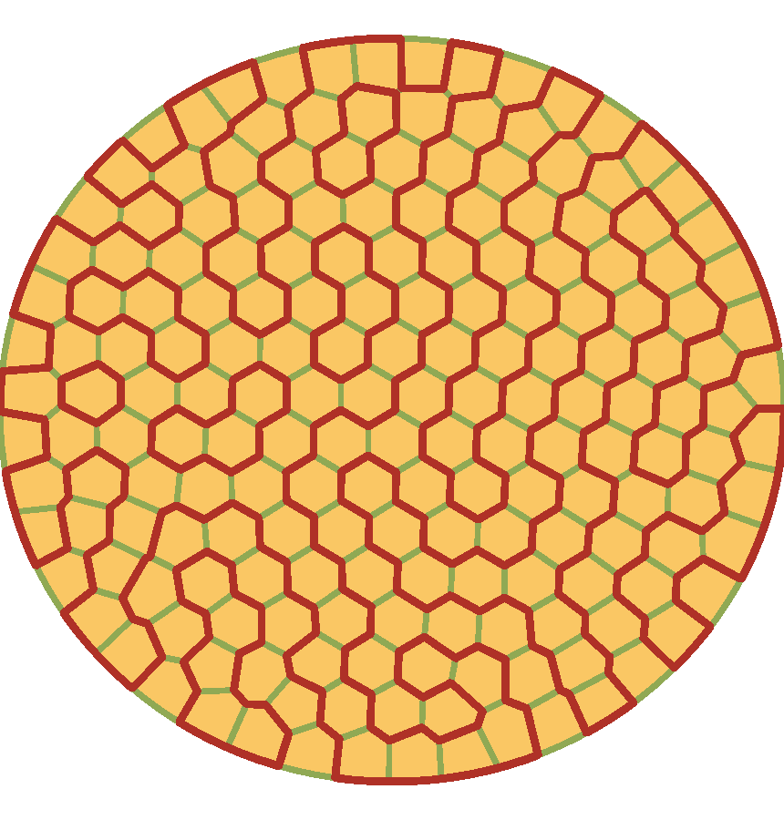
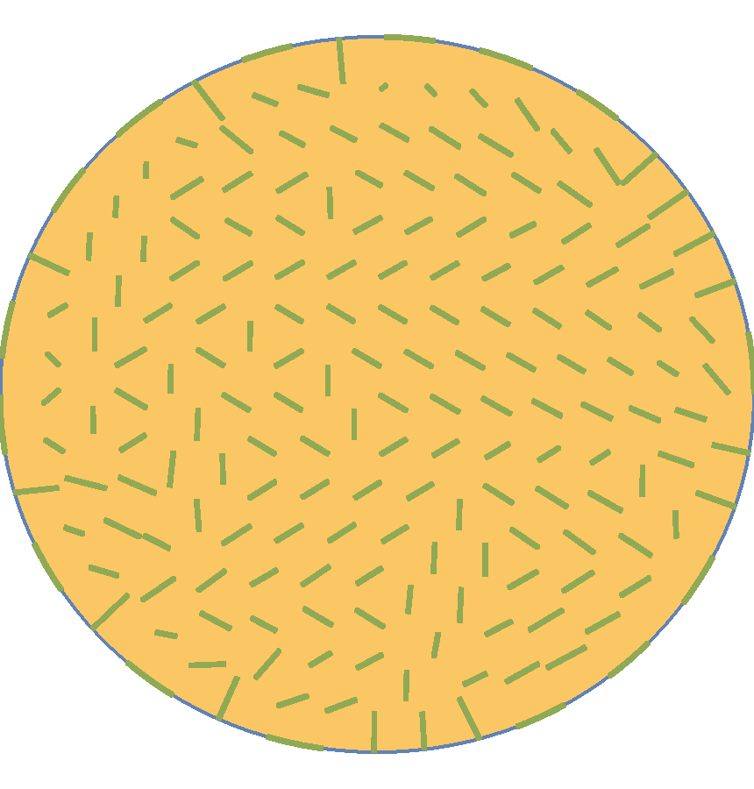
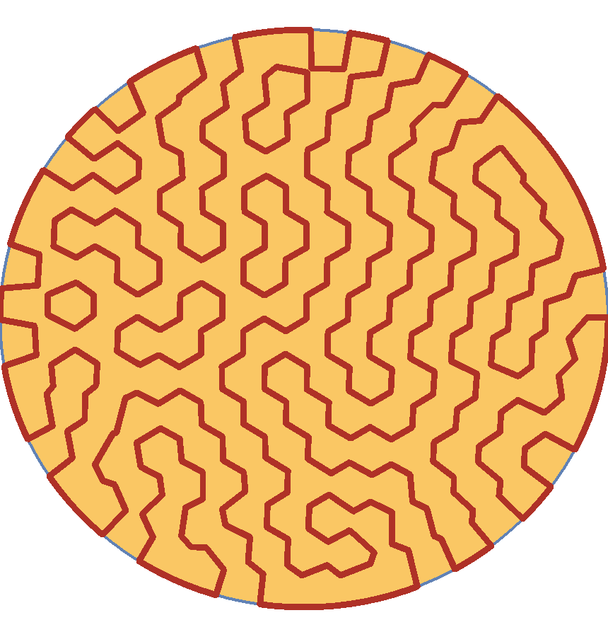
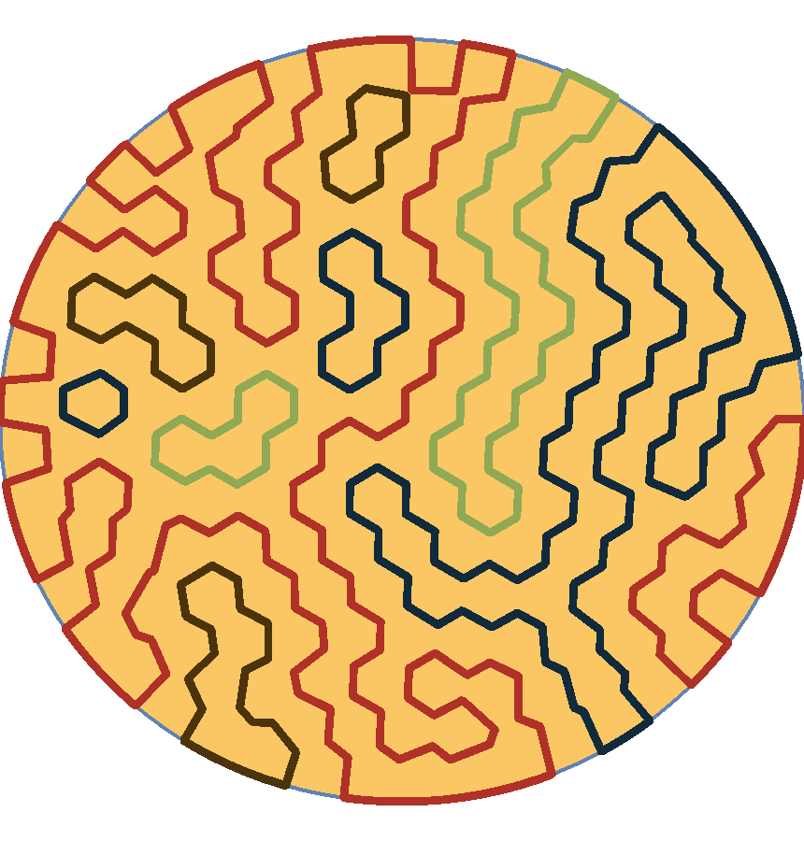
Cycle Initialization
Petersen's Theorem: Every cubic, bridgeless graph contains a perfect matching.
Perfect Matching
Edge Inversion
13
Notes:
Let’s return to our disk. We now want to compute a Hamilton cycle inside the graph. To do so we rely on the Petersen’s theorem stating that « Every cubic, bridgeless graph contains a perfect matching ». Here Cubic means that every vertex should be adjacent to exactly three edges and bridgeless means that we can’t split the graph in two connected components by removing one edge.
These two properties are satisfied by our Voronoi graph.
Thus, there is a perfect matching, which means that we can select a set of edges such that each vertex is adjacent to exactly one selected edge. The perfect matching is shown in green here.
By reversing our selection, we obtain a set of disjoint cycles, as each vertex becomes adjacent to exactly two selected edges.
What remains to do is to merge the cycles (represented with different colors) into one single Hamilton cycle.

Slide 14
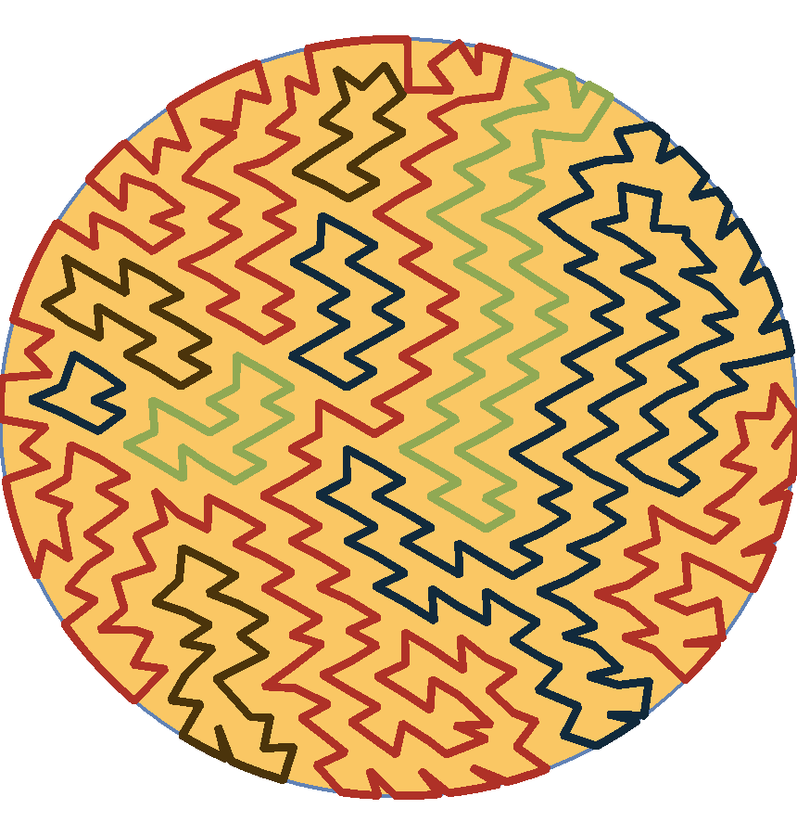
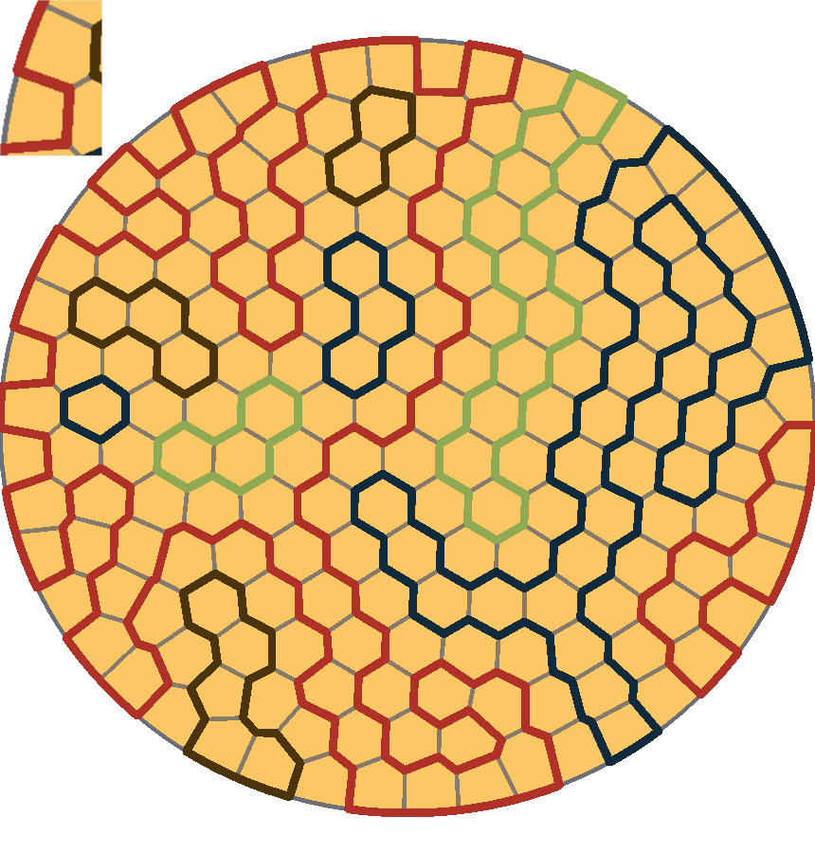
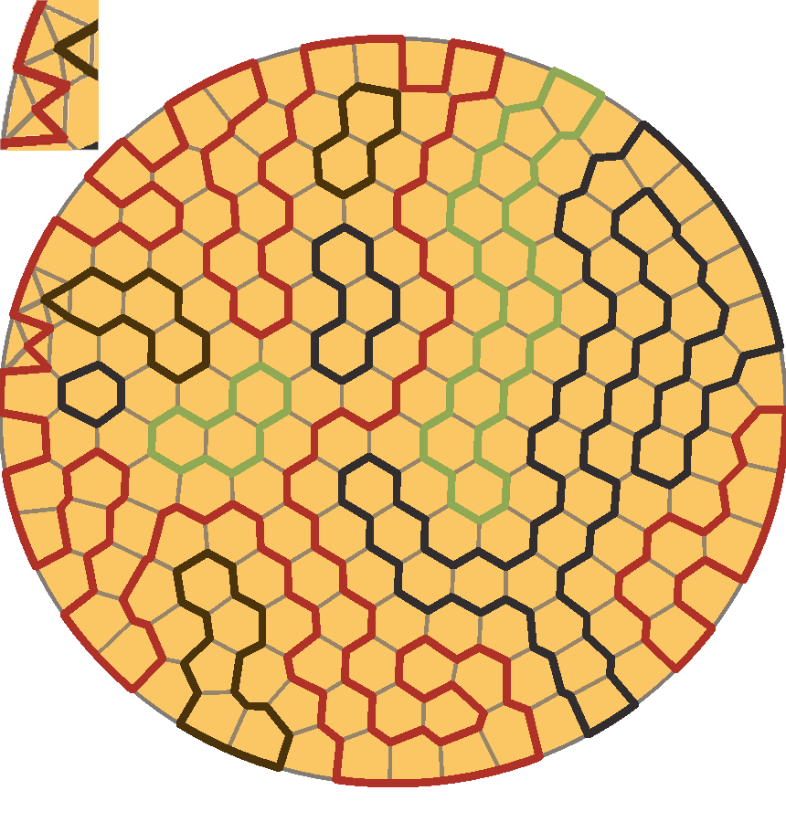
Graph Refinement
14
Notes:
To make merging easier we refine the graph by adding new vertices and edges.
We first start redrawing the underlying graph in gray.
The idea will be to add the cell centers to our graph. Take for example the centers of these two cells. We want to add them to the graph and connect them to a cycle in the same time.
To do so, we choose one edge belonging to a cycle in each cell and split it in two edges passing through the added center.
We also connect each vertex of a cell to its center inside our graph.
Finally we repeat the process for all cells giving us a refined graph.

Slide 15
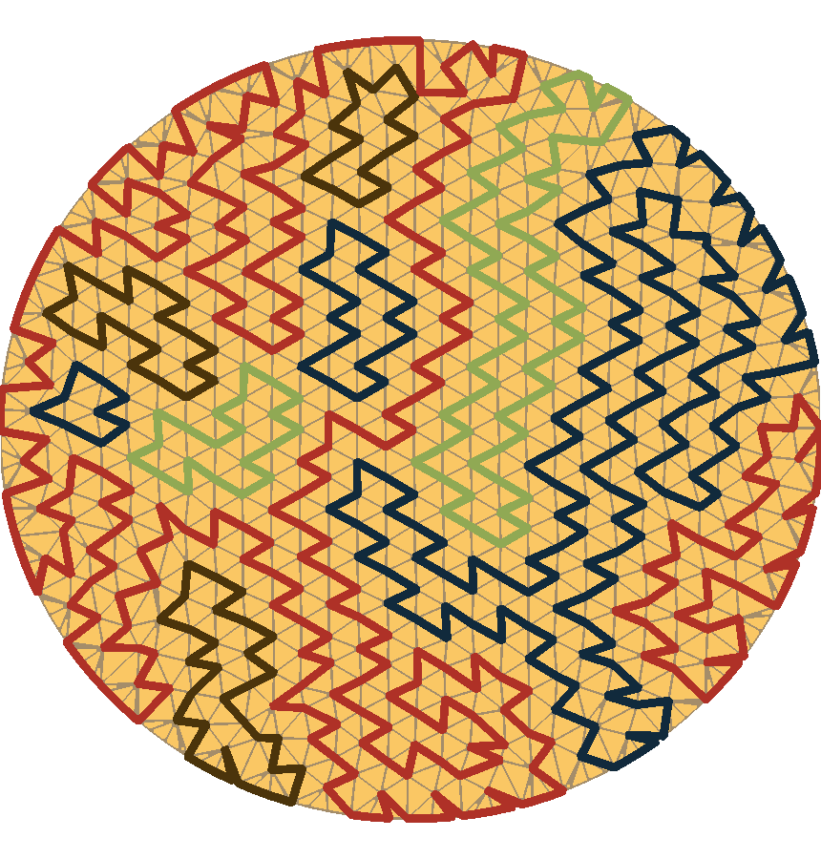
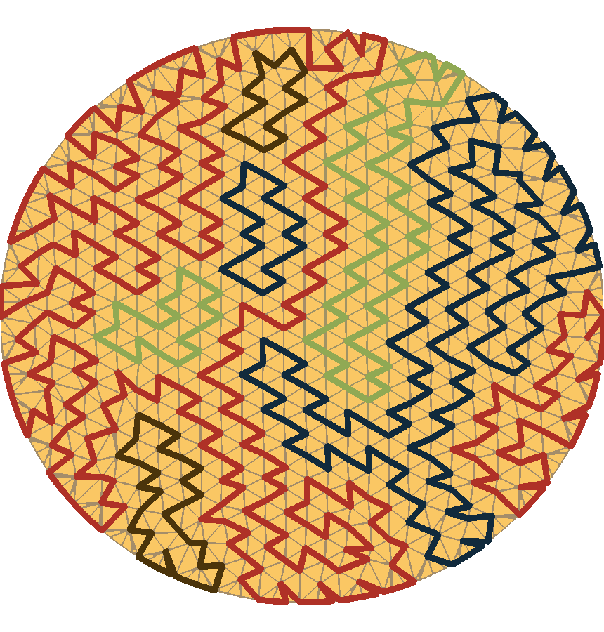
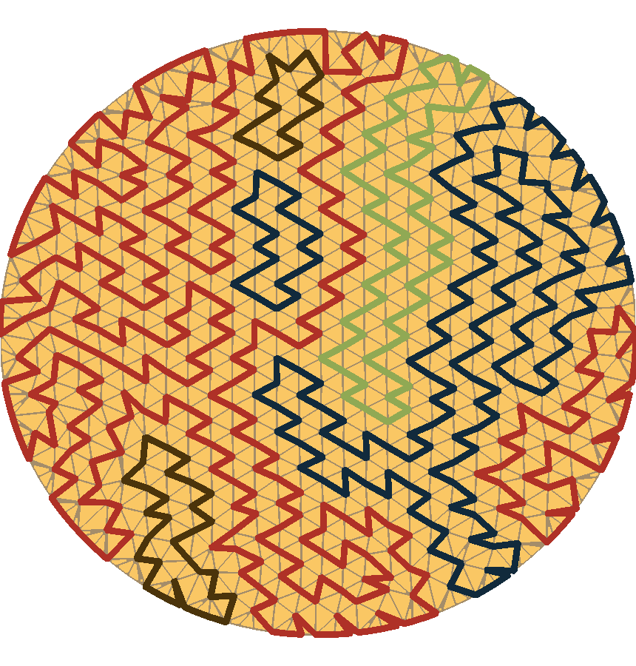
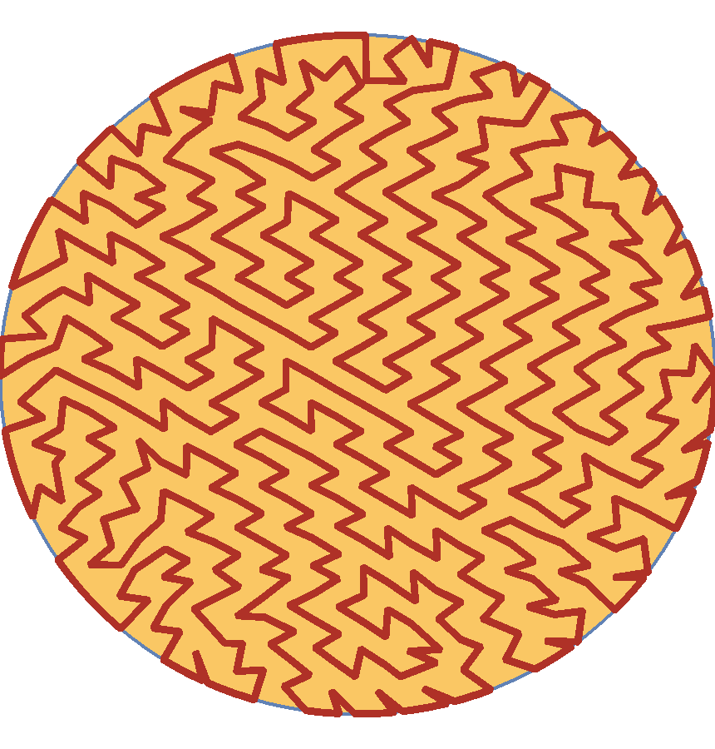
Cycle Merging
15
Notes:
We are now able to find many configurations that allow for easy merging.
For example, here we can flip parallel edges of two different cycles into these new purple edges in order to fuse the big red cycle with the small blue one.
The same operation can be reapeated here.
And there again.
Finally the process ends to an initial Hamilton cycle.

Slide 16
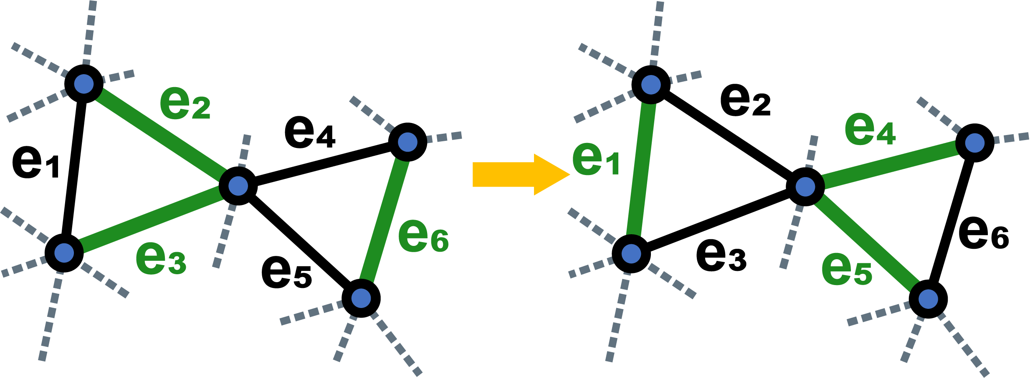
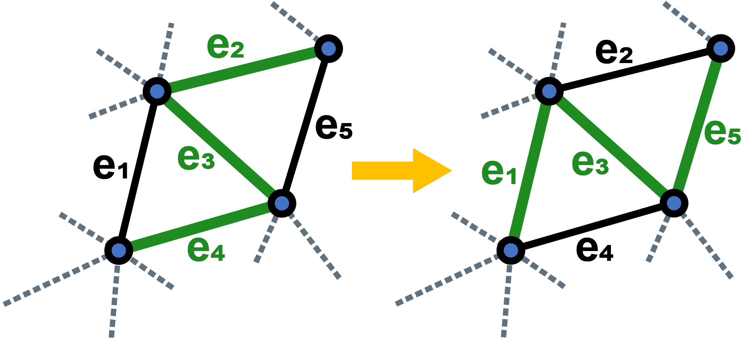
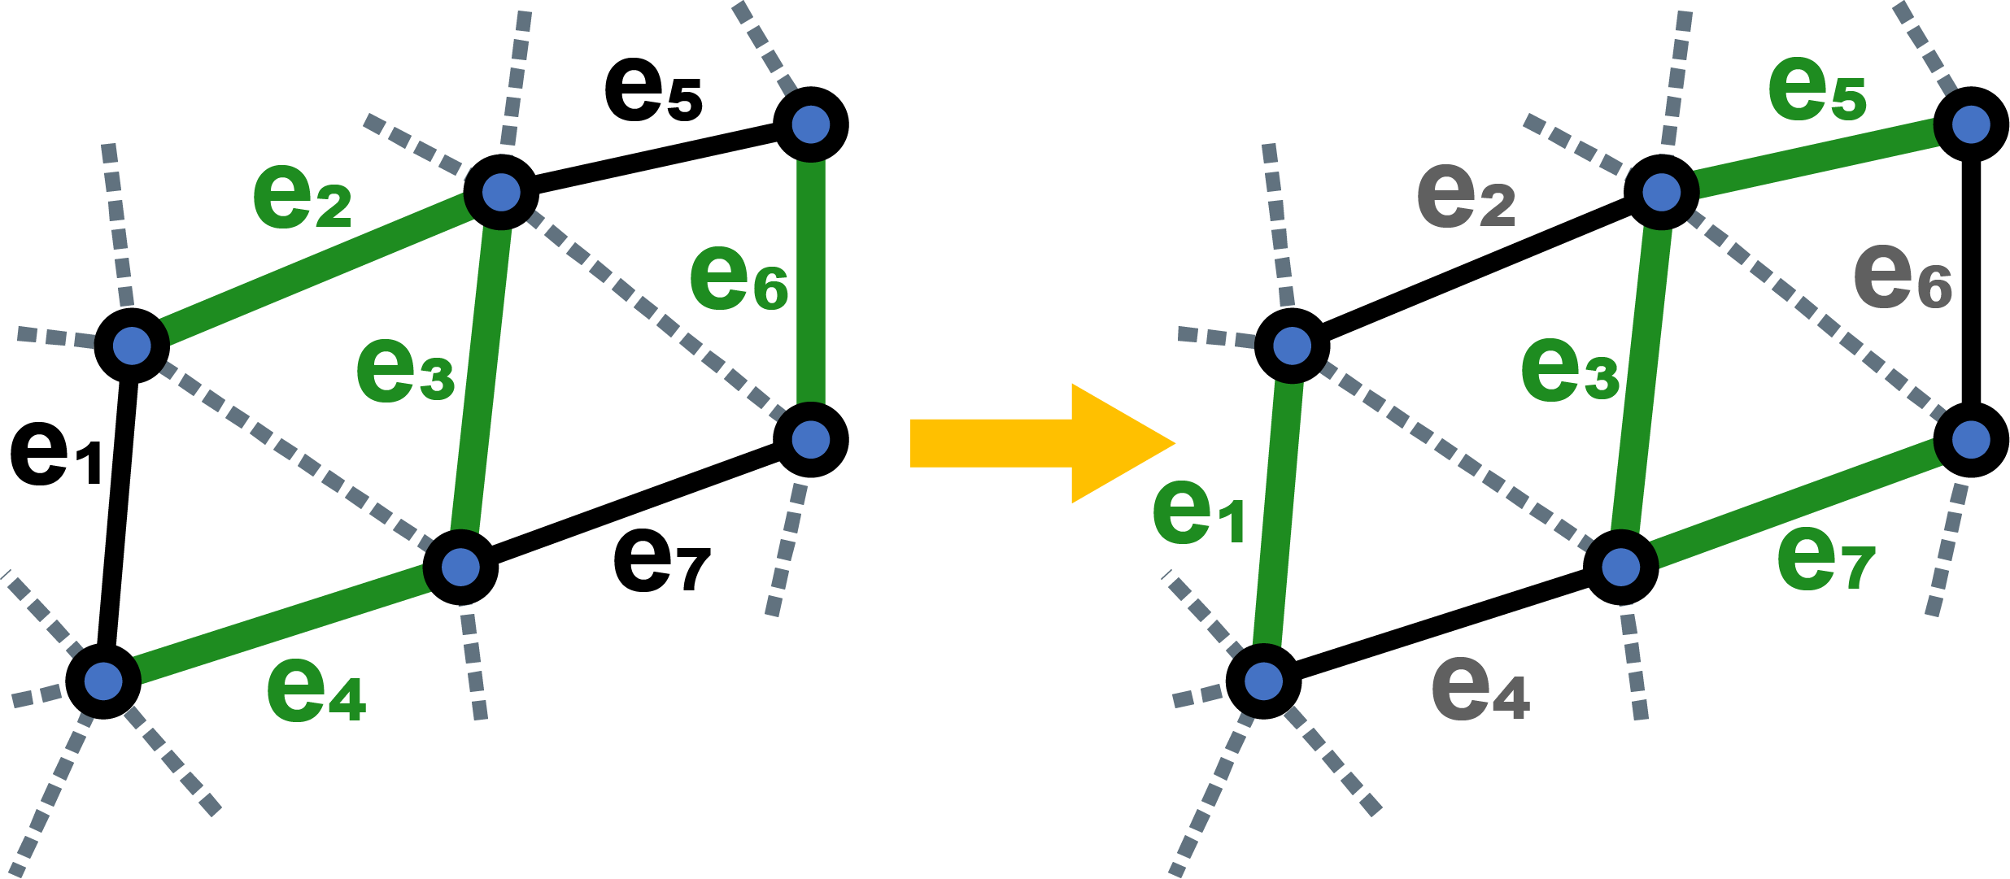
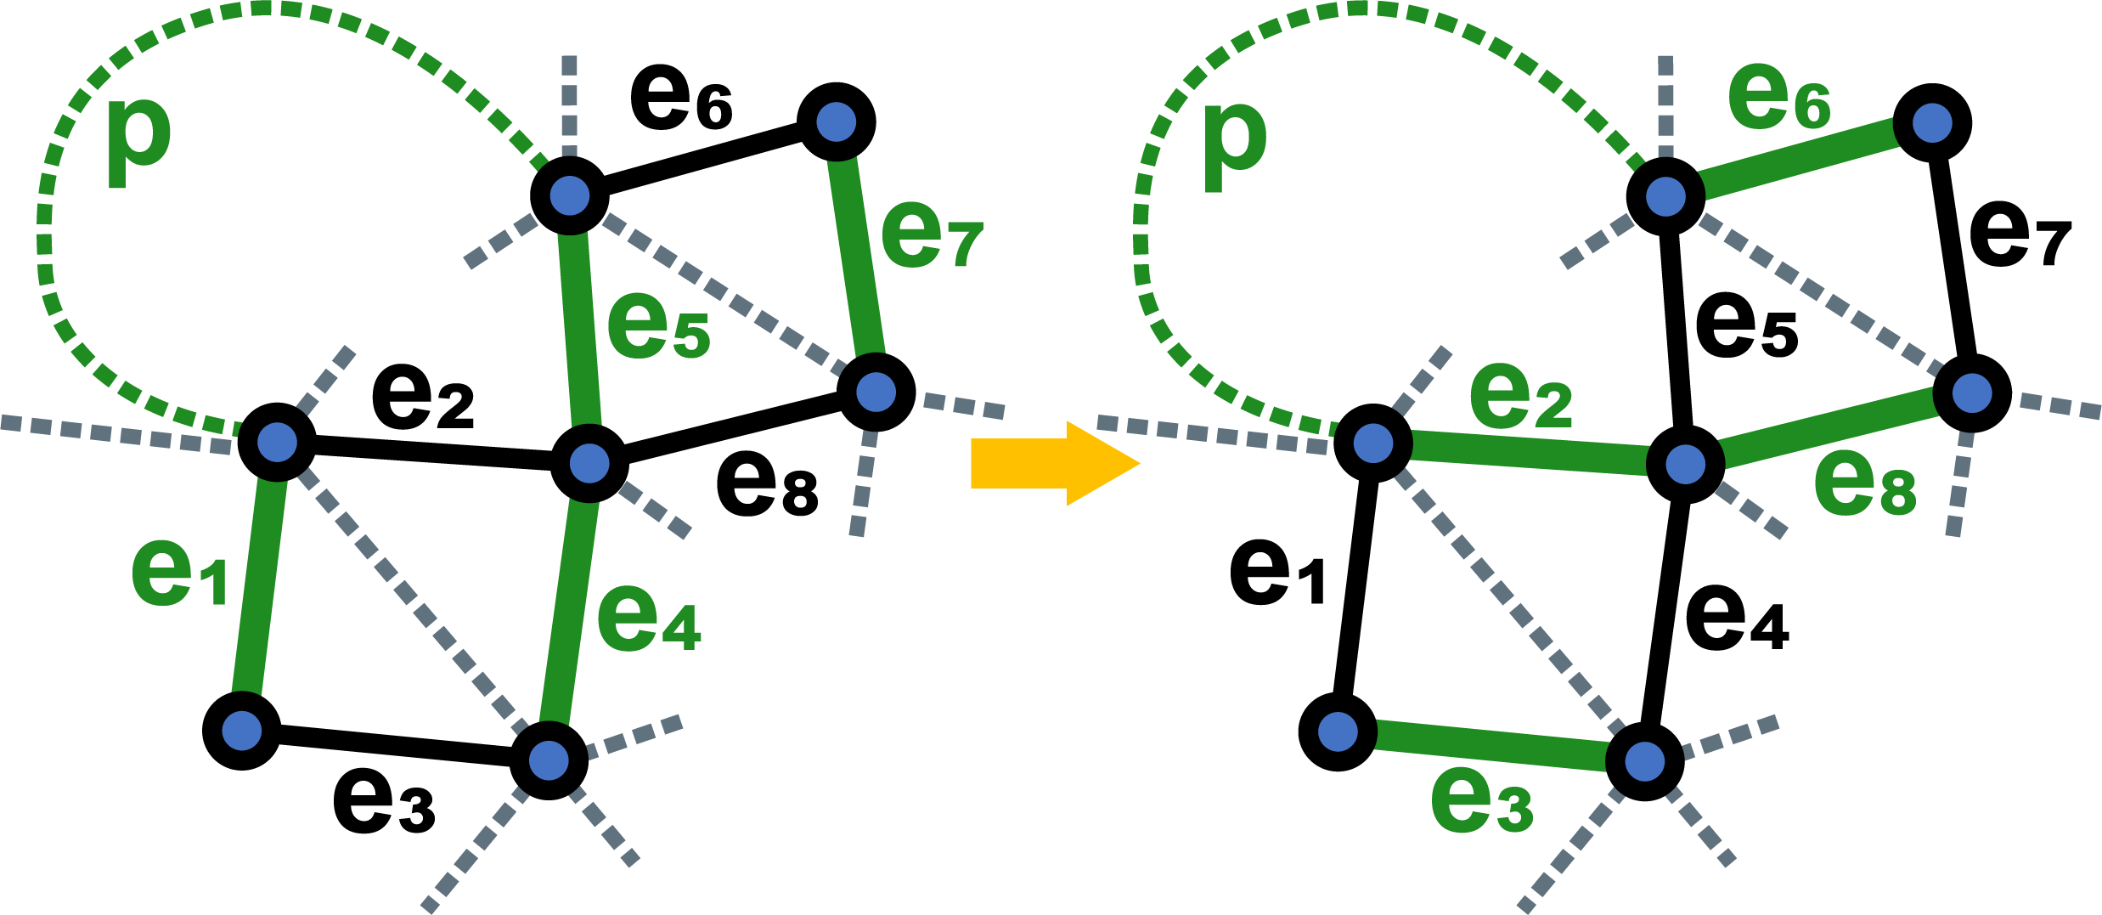
Combinatorial Optimization
16
Notes:
We can then optimize the cycle by applying four kind of local operations that preserve the Hamiltonian property. They are all represented here.
Let’s take the first one. This is a configuration involving 5 nodes and 6 graph edges. The green edges belongs to the Hamilton cycle while black ones are just graph edges not used by our cycle. It turns out that switching from the state where e2, e3 and e6 belong to the path to the state where e1, e4 and e5 belong the trajectory preserve the cyclicity of the path.
This operation as well as two others require a very local connectivity check.
However the last one very useful in practice requires to check that there exists a path P in the cycle that connects two nodes without traversing any other node in the illustration.

Slide 17
Combinatorial Optimization
We define an Energy to minimize:
$$E_{Comb}\left(T\right)=E_{Zon}+γ_{Comb}\left(E_{Ali}+E_{Ori}\right)$$
is the current trajectory
$$T$$
simply counts the number of color transitions in
$$E_{Zon}$$
$$T$$
is a constant controlling the importance of Orientation objectives.
$$γ_{Comb}$$
$$E_{Ali}$$
is an energy measuring vector field Alignment (Lower is better).
$$E_{Ori}$$
is an energy measuring Anisotropy/Isotropy (Lower is better).
17
Notes:
The idea of the Combinatorial Optimization is to use a genetic algorithm trying to apply previous operations to minimize an energy. What remains to do is to define this energy. Here is its expression as given in the paper. We call the Energy of this stage E_comb where comb refers to Combinatorial.
Here, T, is the trajectory we are optimizing.
Then E_comb is divided in two parts. The first one is an energy E_zon simply counting the number of color transition since we want to minimize this value.
The second part concerns the orientation.
It starts with a multiplicative constant gamma_comb controlling the importance of orientation.
Followed by the sum of two energies, one measuring vector field Alignment.
The other measuring Anisotropy or Isotropy in different zones of the surface.
In both cases Lower is better.
Due to time constraints we won’t enter into the details of the alignment energy but we can take a quick look at the energy measuring Isotropy

Slide 18
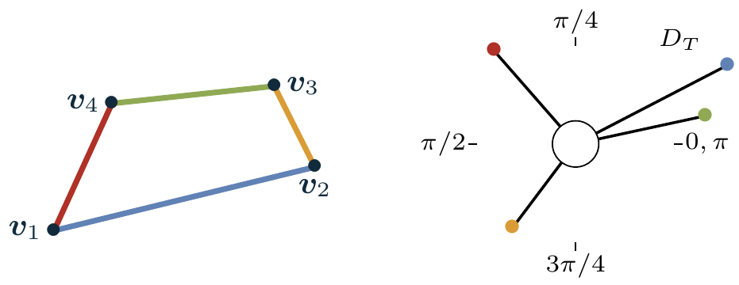
Orientation Energy
When Optimizing for Isotropy, we set:
$$E_{Ori}\left(T\right)=W_{2}^{2}\left(D_{T},U\right)$$
is the 2-Wasserstein Distance
$$W_{2}$$
$$T$$
is the orientation distribution of
$$D_{T}$$
is the uniform distribution over
$$U$$
$$\left[0,π\right[$$
$$W_{2}^{2}\left(D_{T},U\right)=\sum_{\left(ij\right)∈T}{\int_{Θ_{ij}^{0}}^{Θ_{ij}^{1}}{{\left(θ−∠\left(v_{j}−v_{i}\right)\right)}^{2}}}dθ$$
Angle of edge (ij) modulo π
When Optimizing for Anisotropy, we set:
$$E_{Ori}\left(T\right)=−W_{2}^{2}\left(D_{T},U\right)$$
18
Notes:
Being isotropic means that the orientation distribution is as uniform as possible.
For those who are familiar with Optimal Transport, this theory provides an interesting distance between probability distributions, called the Wasserstein distance.
When optimizing for Isotopy we decided to set E_Ori to the squared 2-Wasserstein Distance between
the orientation distribution of our trajectory D_T given by a sum of diracs located at each segment angle taken modulo pi
and a Uniform Distribution U over [0, pi].
The two distributions are represented on the right. Four Diracs for the distribution D_T and a uniform density distribution in gray for U.
It is then possible to compute efficiently an optimal transportation map represented by colored portions of the disk here. The blue segment will for instance be mapped to the blue area.
The squared Wasserstein distance is then given by this formula where capital Theta are the extremities of each colored portion.
And where this part is the angle of segment (ij) taken modulo pi.
Finally when we optimize for anisotropy the energy is simply set to the opposite of the Wasserstein distance.

Slide 19
Combinatorial Optimization
Vector Field Alignment
(Orthogonal to contour)
Isotropy
Anisotropy
19
19
19
Notes:
Once the energy is properly defined a genetic algorithm can be used to optimize the combinatorics.
We illustrate it on a brain model containing many zones with different orientation objectives

Slide 20
Combinatorial Optimization
20
Notes:
This is what the optimization process looks like

Slide 21
Combinatorial Optimization
Vector Field Alignment
(Orthogonal to contour)
Isotropy
Anisotropy
21
21
21
Notes:
And here is the result
Quite well? Right?
Let's improve its geometry to better appreciate.

Slide 22
Geometrical Optimization
We define an Energy to minimize:
$$E_{Geom}\left(T\right)=E_{CVT}+γ_{Lap}E_{Lap}+γ_{Len}E_{Len}+γ_{Geom}\left(E_{Ali}+E_{Ori}\right)$$
$$E_{CVT}=\int_{S}{dist}{\left(x,T\right)}^{2}dx$$
Centroidal Voronoi Tesselation to achieve even spacing.
$$v_{i}$$
$$E_{Lap}=\sum{{\left\|v_{i}−\frac{1}{2}\left(v_{next\left(i\right)}+v_{prev\left(i\right)}\right)\right\|}^{2}}$$
Laplacian Smoothing term
$$v_{next\left(i\right)}$$
$$E_{Len}$$
$$v_{prev\left(i\right)}$$
is a length regularization term
$$\frac{1}{2}\left(v_{next\left(i\right)}+v_{prev\left(i\right)}\right)$$
All Gradients are efficiently computable!
We use a L-BFGS solver
22
Notes:
To optimize the geometry we define a new energy E_Geom that will be minimized by modifying the coordinates of the vertices of our cycle.
As before some constants named gamma are used to control the importance of different objectives.
A first term E_CVT is for even spacing. It is the same Centroidal Voronoi Tesselation Energy used in the graph construction. But here the seeds and needles are replaced by the edges of our cycle.
A second term E_Lap is a Laplacian Smoothing Energy Encouraging straight lines instead of curved ones.
Another Term is Regularizer maintaining the length of the cycle as the CVT Energy tends to increase the length to better cover the whole surface.
Finally the last part of E_Geom is the same as for E_Comb, optimizing for orientation.
It turns out that all these energies have a gradient efficiently computable allowing us to use a Quasi Newtonian Solver LBFGS.

Slide 23
Geometrical Optimization
23
Notes:
And now let's watch a video of geometric optimization.

Slide 24
Geometrical Optimization
24
Notes:
See how well the orientation objectives are met :
For Anisotropy,
Isotropy,
And vector field alignment

Slide 25
Results
25
Notes:
Here are some prints obtained with our method.
The Zebra is particularly difficult to produce since a continuous trajectory has good reasons to have many transitions between the white and black colors.
Here the problem is relatively unobtrusive thanks to the contour aligned objective in the white areas and thanks to the minimization of color transitions.

Slide 26
Results
Ours
[Zhao et al. 2016]
[Pedersen et al. 2006]
26
Notes:
Finally, we show a comparison with Fermat Spirals in the middle and the Pederson trajectories at the right.
We obtain a better even spacing compared to Zhao et al. Especially near medial axis.
Compared to growing processes like Pedersen we are able to make a single pass through narrow corridors as can be seen in the lower left close-up. While a single pass is impossible for growing processes.
Finally it is possible to define different orientation objectives in our method which was not possible in previous works.
Thanks for your attention!!

Slide 27
Smoothness Ablation
27

